Slide 1

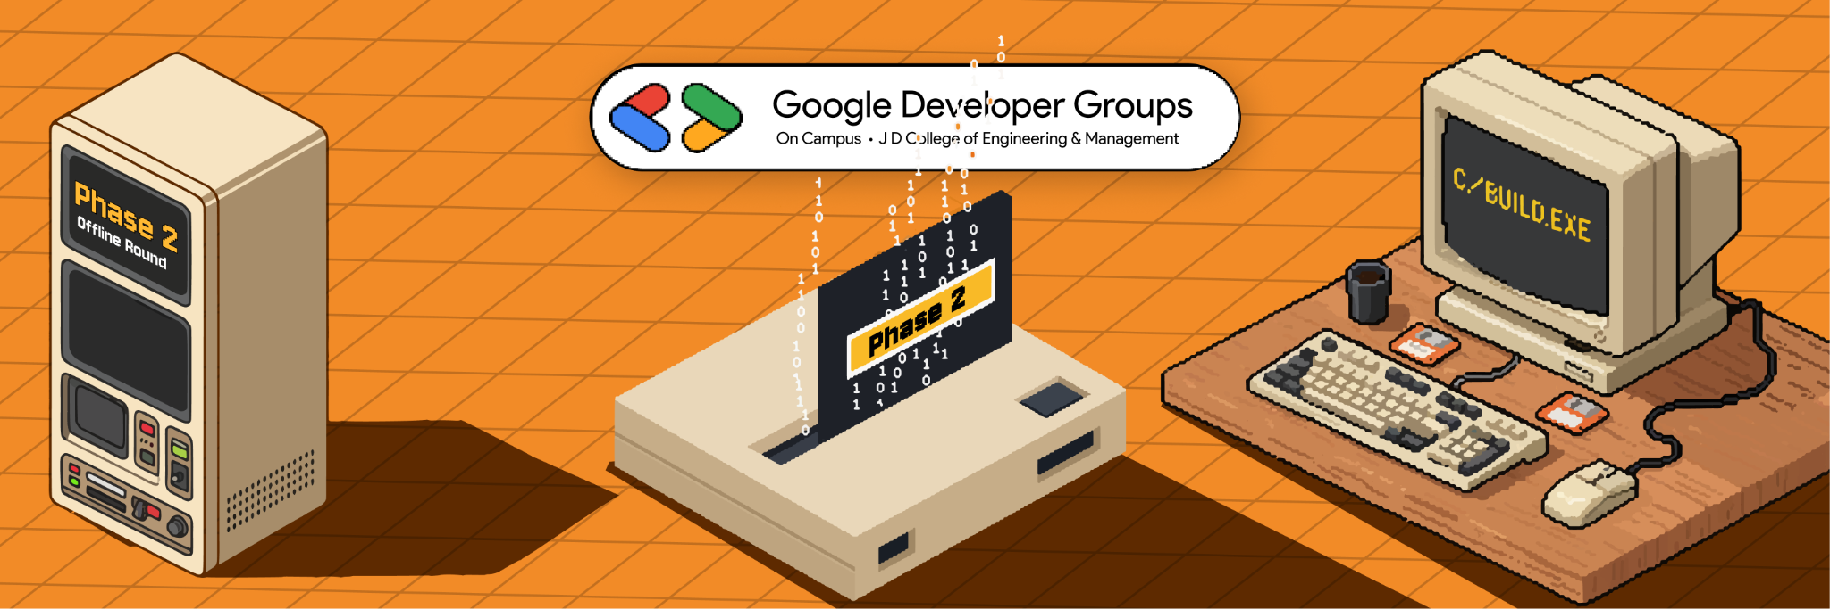
Team Details
Team name: FalconX
Team leader name: Yash Bhoyar
Problem Statement:Developing personalized career guidance solutions for students using technology.
Collage Name:Jhulelal Institute Of Technology Nagpur

Slide 2

Team Member List
Yash Bhoyar
Sayali Pardhi
Pragati Hage
Aachal Bhudke
Team Members Details :

Slide 3


Many students are confused while choosing careers
Lack of proper career guidance, especially in rural areas
Limited awareness of career options and emerging fields
Wrong career choices lead to dropouts and dissatisfaction

Slide 4

Opportunities
How different is it from any of the other existing ideas?
Uses AI for personalized career guidance instead of generic counseling
Focuses on individual student interests, aptitude, and skills
Designed for both rural and urban students
Combines assessment, recommendations, and roadmap in one platform
How does it solve the problem?
Reduces confusion by providing clear career direction
Suggests best-fit career paths early
Helps students understand required skills and learning path
How will it be able to solve the problem?

Slide 5

Key Features of the Solution
Career assessment quiz (Interest, Aptitude, Skills)
AI-based personalized career recommendations
Skill-gap analysis
Personalized career roadmap
Course and learning suggestions
AI chatbot for career guidance and support

Slide 6
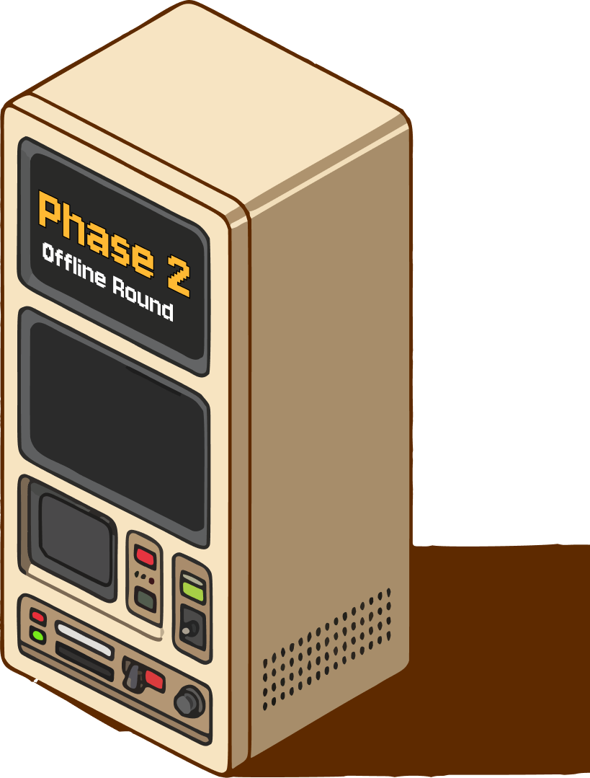
Google Technologies used in the solution
Frontend: HTML,CSS, JAVASCRIPT
Backend: firebase,MongoDB
Google Technologies Used :
Firebase Authentication – Secure Google Sign-In
Firebase Firestore – Real-time cloud database

Slide 7

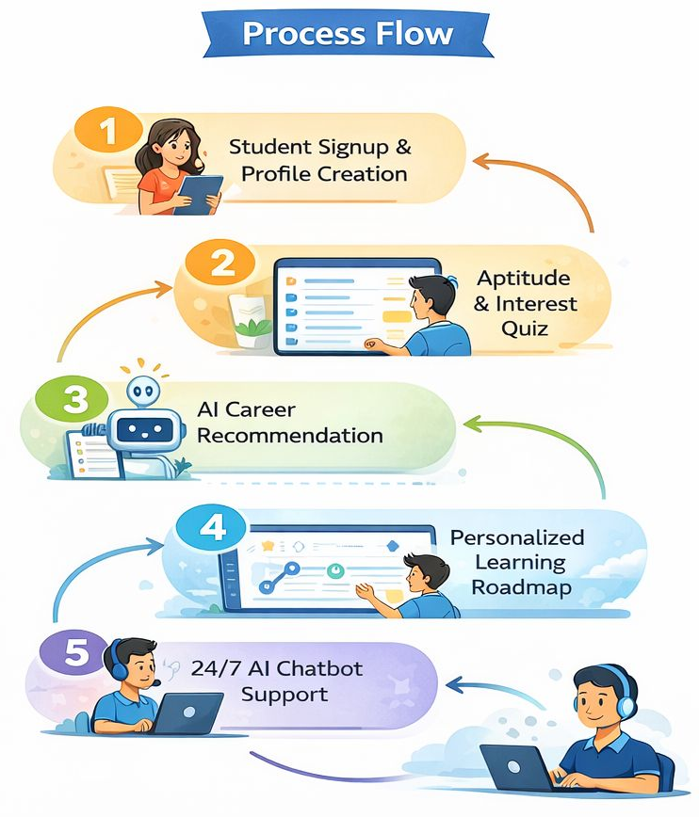

Slide 8
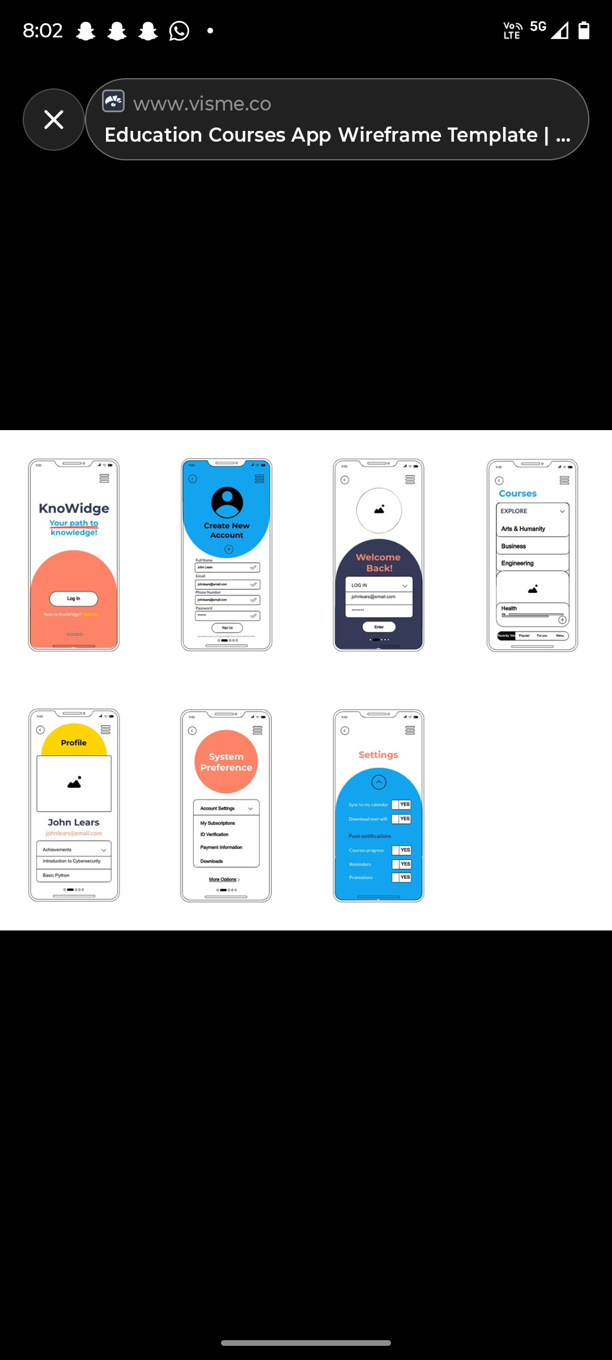
Wireframes :

Slide 9
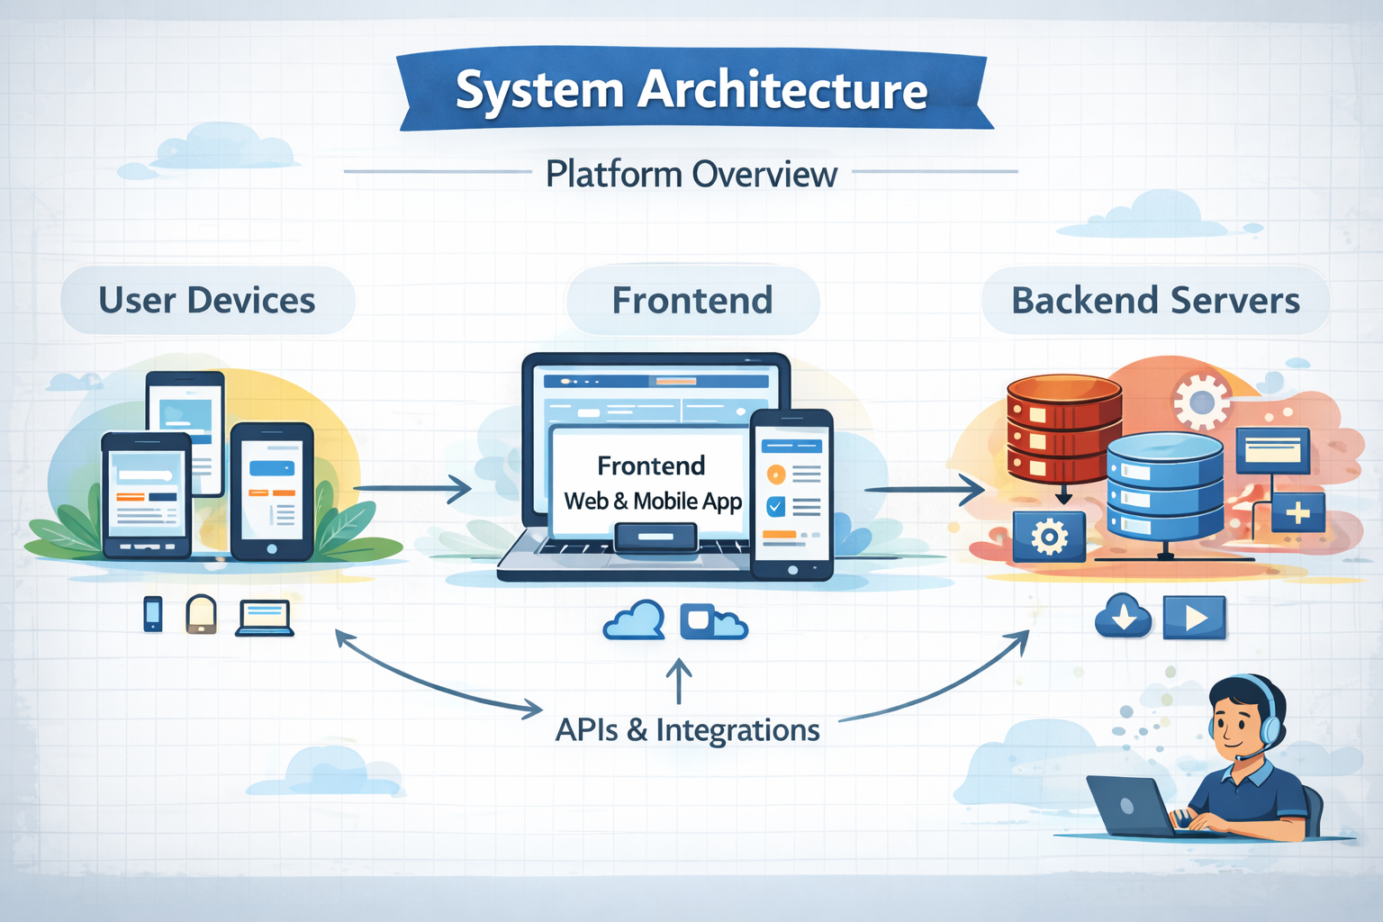

Architecture

Slide 10

MVP Link (Project Link)
http://localhost:5173/

Slide 11

Snapshots of the MVP

Slide 12

Future Development
Add more career paths and domains
Improve skill assessment with more questions
Provide learning resources for skill improvement
Add progress tracking for students
Include college and course recommendations
Enhance system using data-driven logic in future

Slide 13

Provide links to your:
GitHub Public Repository
Demo Video Link (3 Minutes)
MVP Link

Slide 14

Thank you!

